Slide 1
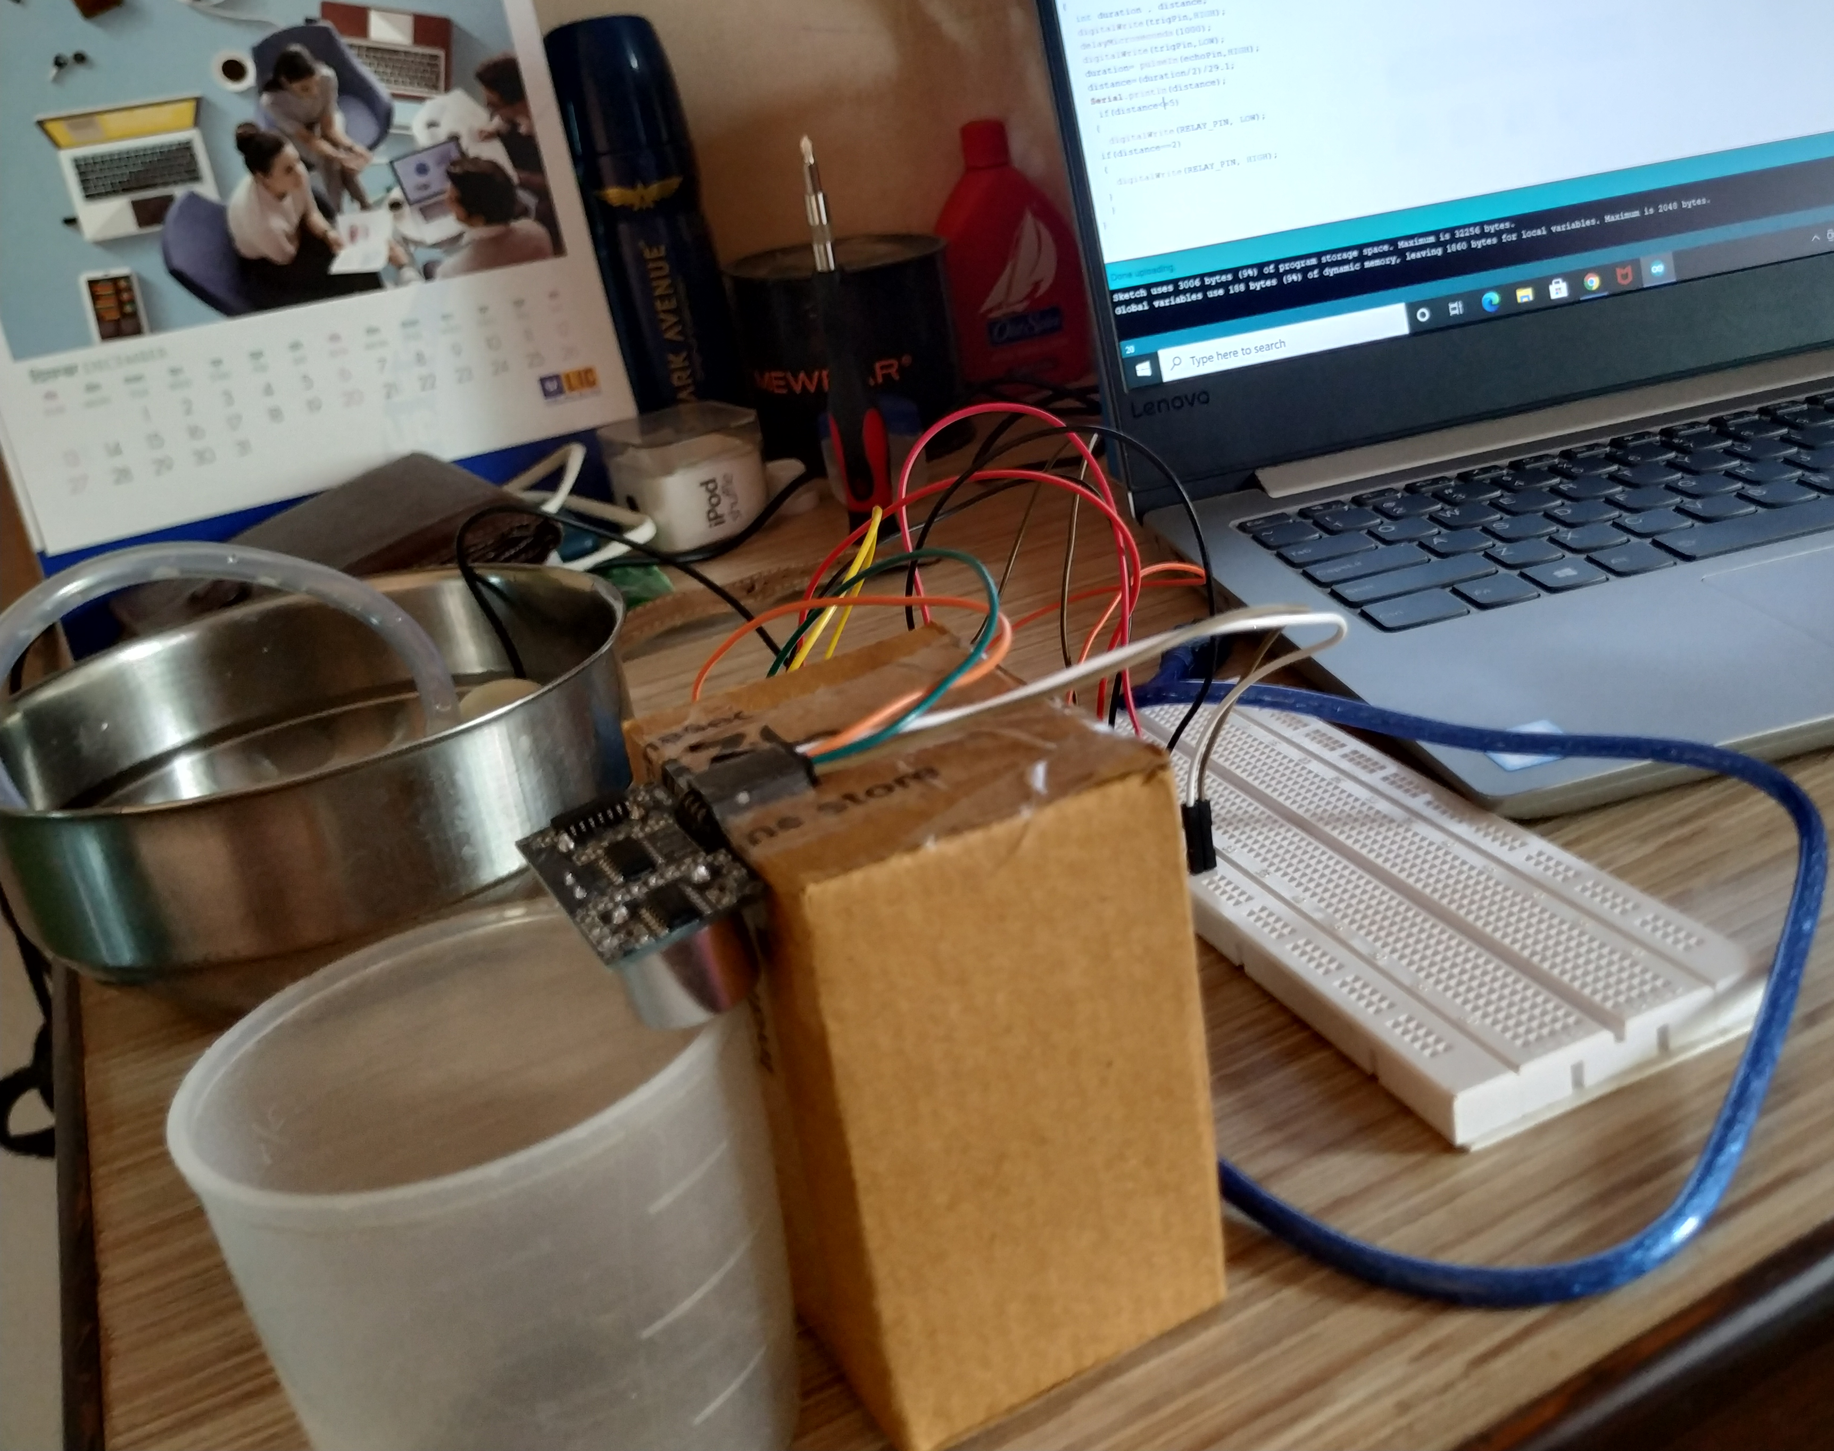
ADVANCED WATER PUMP SYSTEM

Slide 2
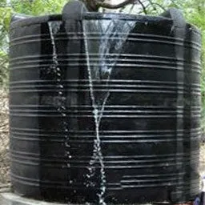
Problem Statement
Need of this project is to avoid wastage of domestic water.Because sometimes people forget to off the motor when tank is full and that water get wasted. To avoid this problem this project came into picture. This Project has been built keeping in mind the domestic wastage of water and to reduce them as much as possible as now in 2020 water crisis is one of the most threatening issue.
Project Brief
In this project our main objective is to fill the water tank with the help of a complete automated water supply system and also an auto alarming system built on it. We are using the IOT technology for making our project along with some sensors and microcontrollers. This will be a mini project which can be used in large scale Home Automation System.

Slide 3
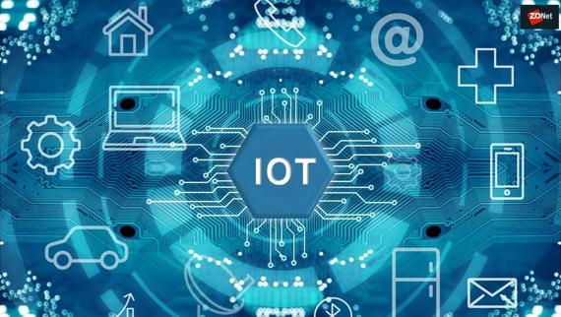
What is IOT ?
IoT is an expanding network of physical devices that are linked with different types of sensors and with the help of connectivity to the internet, they are able to exchange data. Through IoT, internet has now extended its roots to almost every possible thing present around us and is no more limited to our personal computers and mobile phones.

Slide 4
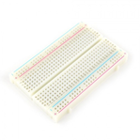

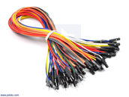

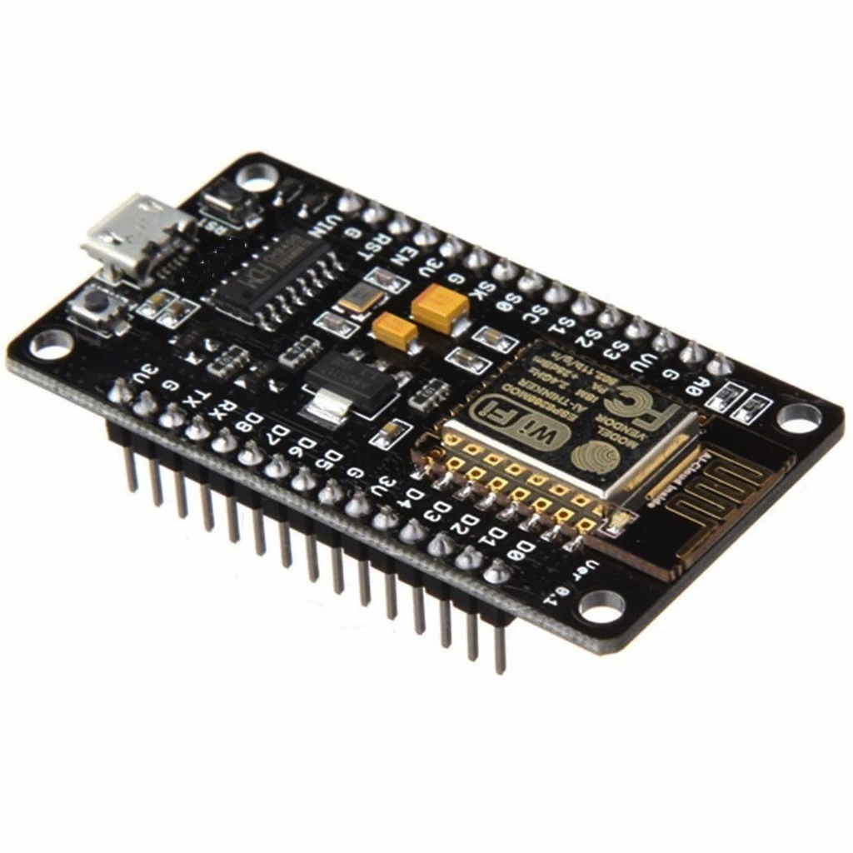

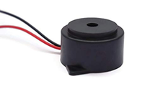
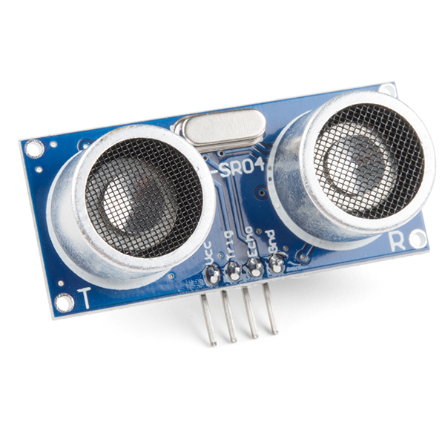

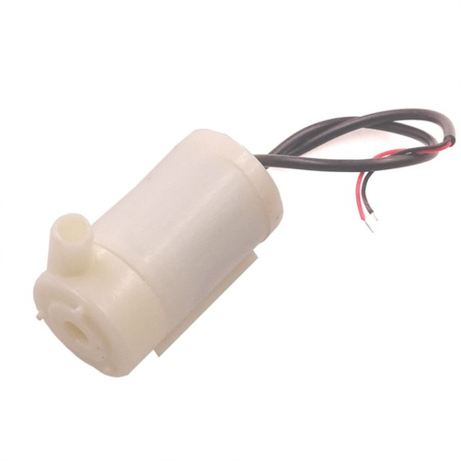
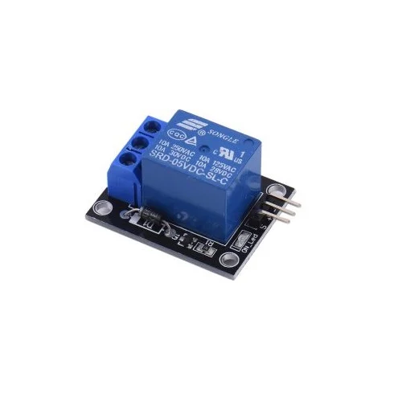

Components Used
Hardware: Softwares:
Breadboard
Jumper Wires
Node MCU
Buzzer
Ultrasonic Sensor
Water Pump
Relay(5v)
Adafruit Cloud
IFTTT APP
Arduino IDE
Embedded C

Slide 5
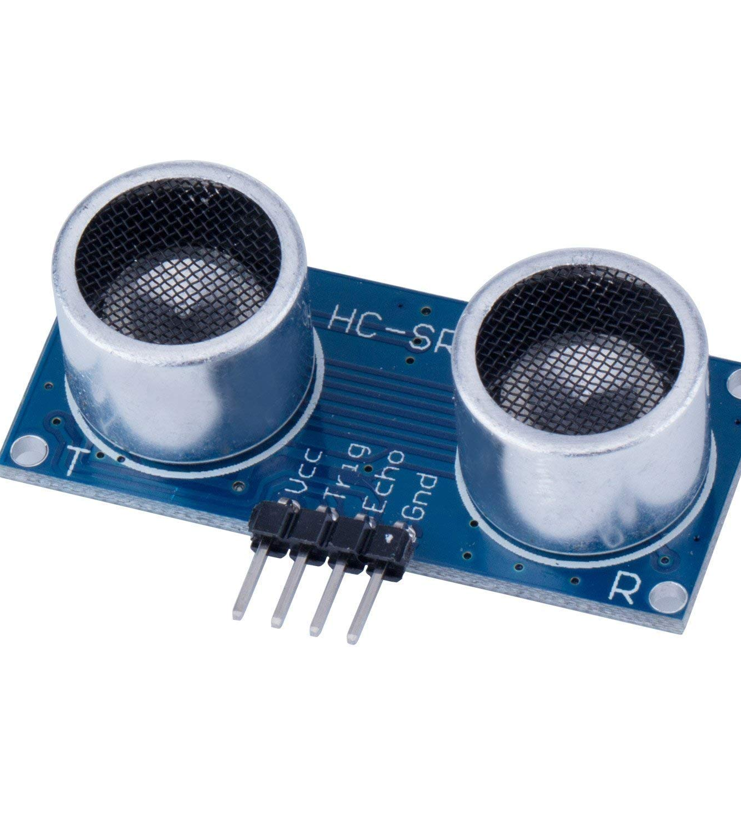
Ultrasonic Sensor
Pins:
1. Vcc- Used to power the sensor, generally the operating voltage is +5v.
2. Ground- Connects the module to the system ground.
3. Trig-This pin has to be kept high for 10ms to initialize measurement by sending us waves.
4.Echo-Output pin. Goes high for a time period which is equal to time taken for the wave to travel back.
Working Principle:
Basic principal of ultrasonic distance measurement is based on ECHO. When sound waves are transmitted in environment then they return back to the origin as ECHO after striking on any obstacle.
So we have to only calculate its travelling time of both sounds means outgoing time and returning time to origin after striking on any obstacle. And after some calculation we can get a result that is the distance. This concept is used in our water controller project where the water motor pump is automatically turned on when water level in the tank becomes low.

Slide 6
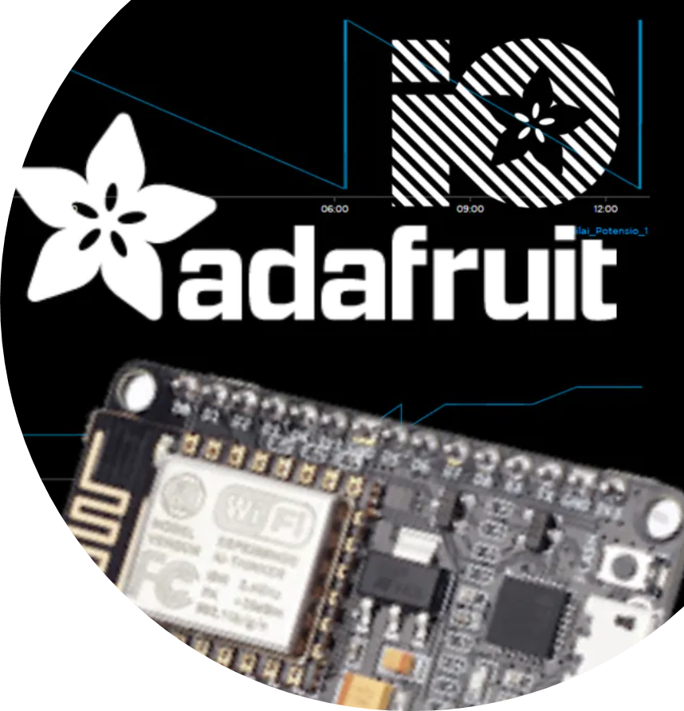
NodeMCU(ESP8266)
NodeMCU is a low-cost open source IOT platform.It initially included firmware which runs on the ESP8266 WIFI Module from Espressif Systems, and hardware which was based on the ESP-12 module.Later, support for the ESP32 32-bit MCU was added.
ADAFRUIT Cloud
Adafruit.io is a cloud service- that just means we run it for you and you don't have to manage it. You can connect to it over the Internet. It's meant primarily for storing and then retrieving data but it can do a lot more than just that!

Slide 7
Working Principle
Working of this project is very simple I have used Ultrasonic sensor module which sends the sound waves in the water tank and detects reflection of sound waves that is ECHO. First of all I need to trigger the ultrasonic sensor module to transmit signal by using Arduino and then wait to receive ECHO. Arduino reads the time between triggering and received ECHO.
Once the water level of the tank has been measured , the microcontroller can easily operate the water pump with the help of relay to fill up the water tank up-to the level we want.
We have added an alarming system with the help of IOT and the required softwares in case their occurs any kind of malfunction in our system which can lead to a greater loss of domestic water wastage.

Slide 8
Circuit Diagram

Slide 9

Advantages:
Power Saver
Save money by using less electricity and water
Sends an alert
Automatically adjust water levels
Applications:
Can be used in factories , complexes.
Fuel Tank level gauging
Advanced Water pump systems
Advanced Irrigation Control

Slide 10


